Slide 1
Reduce Workload Production : Auto Pick List Raw Materials to Angel Store (Auto GI)

Slide 2





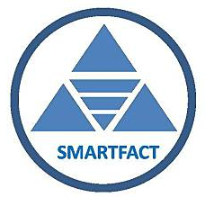
Reduce Workload Production : Auto Pick List Raw Materials to Angel Store (Auto GI)
As is
Paper
Key in
Approve
To be
Machine
MES
Approve

Slide 3
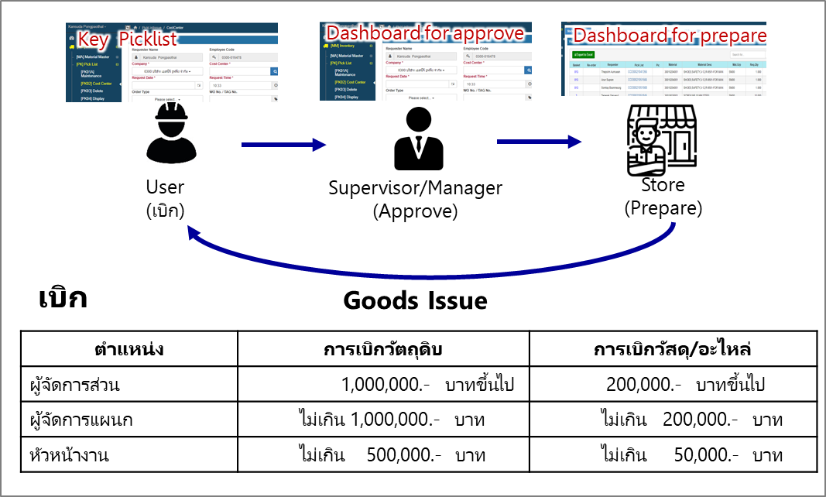
Reduce Workload Production : Auto Pick List Raw Materials to Angel Store (Auto GI)
สรุป Flow การเบิกของ
Details
Price for calculate : Avg / Fix
Back date function
Use update date or create for check update (every 10 mins)

Slide 4
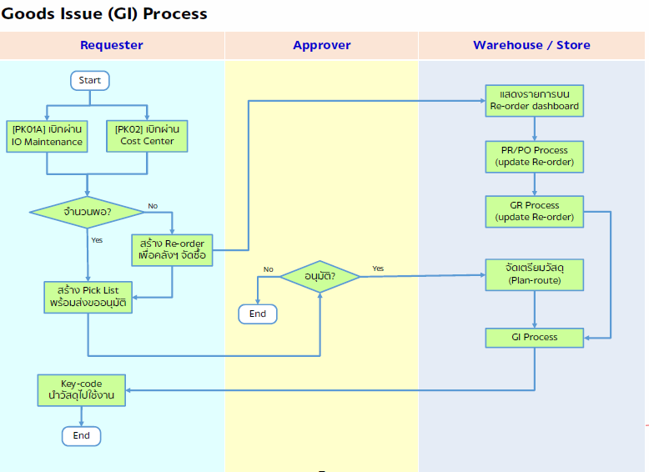
MES to Angel Process
MES → Create Pick List → Approve → GI Process → SAP
MES → Create Task → SAP

Slide 5
Raw Materials Information Flow for MES
Raw Materials Data Collection
Red Text = Manual key in
Process | Details | Data
Body | Cement | Actual Weighing by batch
 | Dry Aggregate | Dry Aggregate = Wet Aggregate – Sand Water Sand Water = Total Water – Water Mixer Sand Water = [ (Cement+Wet Aggregate+Water) x %MM ] – Water Mixer
 | Sand Mix | %S1 = S1 weight x speed / (S1+S2+S3+S4 weight x speed) %S2 = S2 weight x speed / (S1+S2+S3+S4 weight x speed) %S3 = S3 weight x speed / (S1+S2+S3+S4 weight x speed) %S4 = S4 weight x speed / (S1+S2+S3+S4 weight x speed)
 | Sand | Dry Aggregate x (%S1 + %S4 + (%S2x50%))
 | Dust Stone | Dry Aggregate x %S3
 | Regrind Concrete | Dry Aggregate x (%S2x50%)
 | Water | Actual Weighing by batch
 | A/C Ratio | Dry Aggregate / Cement
 | Mold Oil | Mold Oil+Oleic Usage x (1 - %Oleic)
 | Oleic | Mold Oil+Oleic Uasge x (%Oleic)
Slurry | Cement | Actual (Compare with BOM x Batch)
 | Sand | Actual (Compare with BOM x Batch)
 | Water | -
 | ADVA | No. batch count x BOM
 | GC2 | No. batch count x BOM
 | Pigment | Actual by color (Move from Sloc to Sloc T1)
GEP | Clear GEP / Pigmented GEP | Clear GEP / Pigmented GEP Usage
Digital : Weighing by batch
Digital & Calculation : No. batch count x BOM
S2:Sand + Regrind Concrete
**Fix ratio 50% x 50%
S3:Dust Stone
Manual Key in : Key in by tablet
S1:Sand
S4:Sand
เปลี่ยนเป็นค่า
Actual Mass Flow by Sand Bin
ตัดสัญญาณด้วยกระแสที่บอกว่า Full แล้วเก็บไปเป็น 1 batch
% Weighing by sand bin
Sand Mixer
Sand Mix Current
GEP, Pigmented GEP
Sand
Weighing
Water
Weighing
GC2 Weighing
Cement Weighing
Aggregate
Weighing
Water
Weighing
Cement Weighing
ADVA Weighing
Pigment
Weighing by batch
Weighing by batch
Dry base x Moisture
Mortar Mixer
Slurry Mixer
Tile Count
GEP Coating
Curing Count
De-pallet Count
SMC Stoc : Primary Store 1
Pigment Sloc : T1
Tile Forming
Slurry Coating
Curing
Stockyard
Mold Oil
% Oleic acid

Slide 6
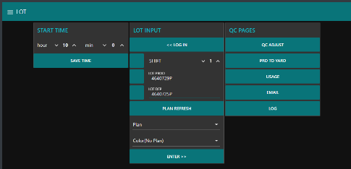

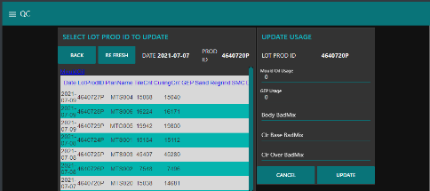
Manual key in
Input Mould Oil, GEP/Pigmented GEP usage, Bad Mix by QC
1. กดเลือก QC Adjust
1
2. กดเลือก Lot ที่ต้องการจะใส่ข้อมูล
3. กดเลือกหัวข้อแล้วใส่ค่า Mould Oil, GEP/Pigmented GEP usage, Bad Mix
4. กด Update
3
2
4

Slide 7
API for GI data (Auto Pick List)
CompID | CompanyCode | CompanyDesc
CP001 | 1220 | บริษัท สยามไฟเบอร์ซีเมนต์กรุ๊ป จำกัด
CP002 | 0180 | บริษัท เอสซีจี ซิเมนต์-ผลิตภัณฑ์ก่อสร้าง จำกัด
CP003 | 0300 | บริษัท เอสซีจี รูฟฟิ่ง จำกัด
CP004 | 0110 | THE SIAM CEMENT PUBLIC COMPANY LIMITED
CP005 | 0210 | THE SIAM FIBRE-CEMENT CO., LTD
CP006 | 0320 | บริษัท เอสซีจี แลนด์สเคป จํากัด
CP007 | 1030 | บริษัทสระบุรีรัชต์ จำกัด
CP008 | 0260 | บริษัทสยามไฟเบอร์กลาส จำกัด
LotProdID (MES)
Approver (Username Master Data)
Requester (Username Master Data)
PlantID | Plant | CompID | Plant_Description
PT001 | C211 | CP001 | SFCG-Lampang
PT002 | C221 | CP001 | SFCG-Tha Luang
PT003 | C231 | CP001 | SFCG-Saraburi
PT004 | C241 | CP001 | SFCG-Thung Song
PT005 | C251 | CP001 | SFCG-Nong Khae
PT006 | C261 | CP001 | SFCG-SDBC Plant
PT007 | 2111 | CP001 | SFCG-Lampang-Old
PT008 | 3031 | CP003 | SCGR Saraburi Plant
PT009 | 3041 | CP003 | SCGR Cholburi Plant
PT010 | 3051 | CP003 | SCGR Nakornprathom Plant
PT011 | 3061 | CP003 | SCGR Lamphun Plant
PT012 | 3071 | CP003 | SCGR KhonKhan Plant
PT013 | 3081 | CP003 | SCGR Nakhon Srithammarat Plant
PT014 | 30A1 | CP003 | SCGR Saraburi 2 Plant
PT015 | 30C1 | CP003 | SCGR TCT Plant
PT016 | 0300 | CP003 | SCGR BangSue
PT017 | 0301 | CP003 | SCGR BangSue-Admin
PT018 | 3002 | CP003 | SCGR BangSue
PT019 | C202 | CP001 | SFCG-Head Office
PT020 | 2121 | CP005 | SFCC Plant
PT021 | 30E1 | CP003 | SCGR-SB4
PT022 | 3241 | CP006 | Landscape LB
PT023 | 3251 | CP006 | Landscape NK
PT024 | 3261 | CP006 | Landscape LP
PT025 | 3271 | CP006 | Landscape KK
PT026 | 3281 | CP006 | Landscape TS
PT027 | 3291 | CP006 | Landscape SR
PT028 | A311 | CP007 | SBR
PT029 | A381 | CP007 | SBR-SB
PT030 | A302 | CP007 | SBR-A302
TimeStamp (MES)
0300 (Fix 0300)
CP003 (Fix CP003)
Free Text
LotProdID (MES)
Run number
Fix “O” (Text O)
อิงตาม Plant (Username Master Data)
อิงตามวัตถุดิบที่เบิก (Materials Code Master Data)
อิงตามวัตถุดิบที่เบิก (Materials Code Master Data)
จำนวนเบิก
SB1-1:3031 / CB:3041)
SB1-1:PT008 / CB:PT009
Fix “0” (Zero)
Plan Receive (today) Date (MES)
Blank
Blank
Unit (Materials Code Master Data)
SB1:PT008 / CB:PT009

Slide 8
API for GI data (Auto Pick List)
Materials Code Master Data of Angel (Material Number / Unit)
GL Account | Name | SAP Mat Code | Unit
703001 | Portland Cement-Bulk Type 1-Elephant | 30100361002
703003 | Limestone Mesh 16
703010 | Sand-Colour Mixing
703011 | Dust Stone | 30100373024
703012 | Sand Body Mixing | 30100263022
703019 | Regrind Concrete | 30100373025
703029 | Pigment Bayer-Red 4125
703032 | Pigment Bayer-Black 318
703033 | Pigment Bayer-Black 330
703036 | Pigment Bayer-Brown 686
703038 | Pigment Bayer-Green GN
703039 | Pigment Bayer-White R-KB-2
703040 | Pigment Bayer-White TR-92
703043 | Pigment Cookson-Blue 34L84
703044 | Pigment Cookson-Blue 36L642
703046 | Pigment - Blue 34L2000
703047 | Pigment-Blue Synox 4810
SLOC | Description
1 | Primary Store
0011 | CS Curing/Repack
0014 | CS Poor Quality
0015 | CS Wait for Scrp
B | BARGE
RI | RIDGE
SR | SPECIAL RIDGE
T1 | TILE1
T2 | TILE2
W | Waste
Username Master Data for MES to Angel (Plant Code / Approve Username / Create Username)
Create Name | Create Username | Approve Name | Approve Username | Plant Code | Sloc | Cost Center
Sangwan Iemjaroen | sangwani | Teerapon Chomgang | teeracho | 3041 | T1 | 0304-53200
Surachot Thongaram | suractho | Amnuay Glingkajorn | amnuayg | 3031 | T1
 |  | Sopon Srinel | sopons | 3031 | T2
Raw Mat Code - GL Account (Auto) ในตาราง Raw Mat Master Data
Surachote - PlatCode - Sloc - CostCenter ในตาราง User

Slide 9
